Slide 1
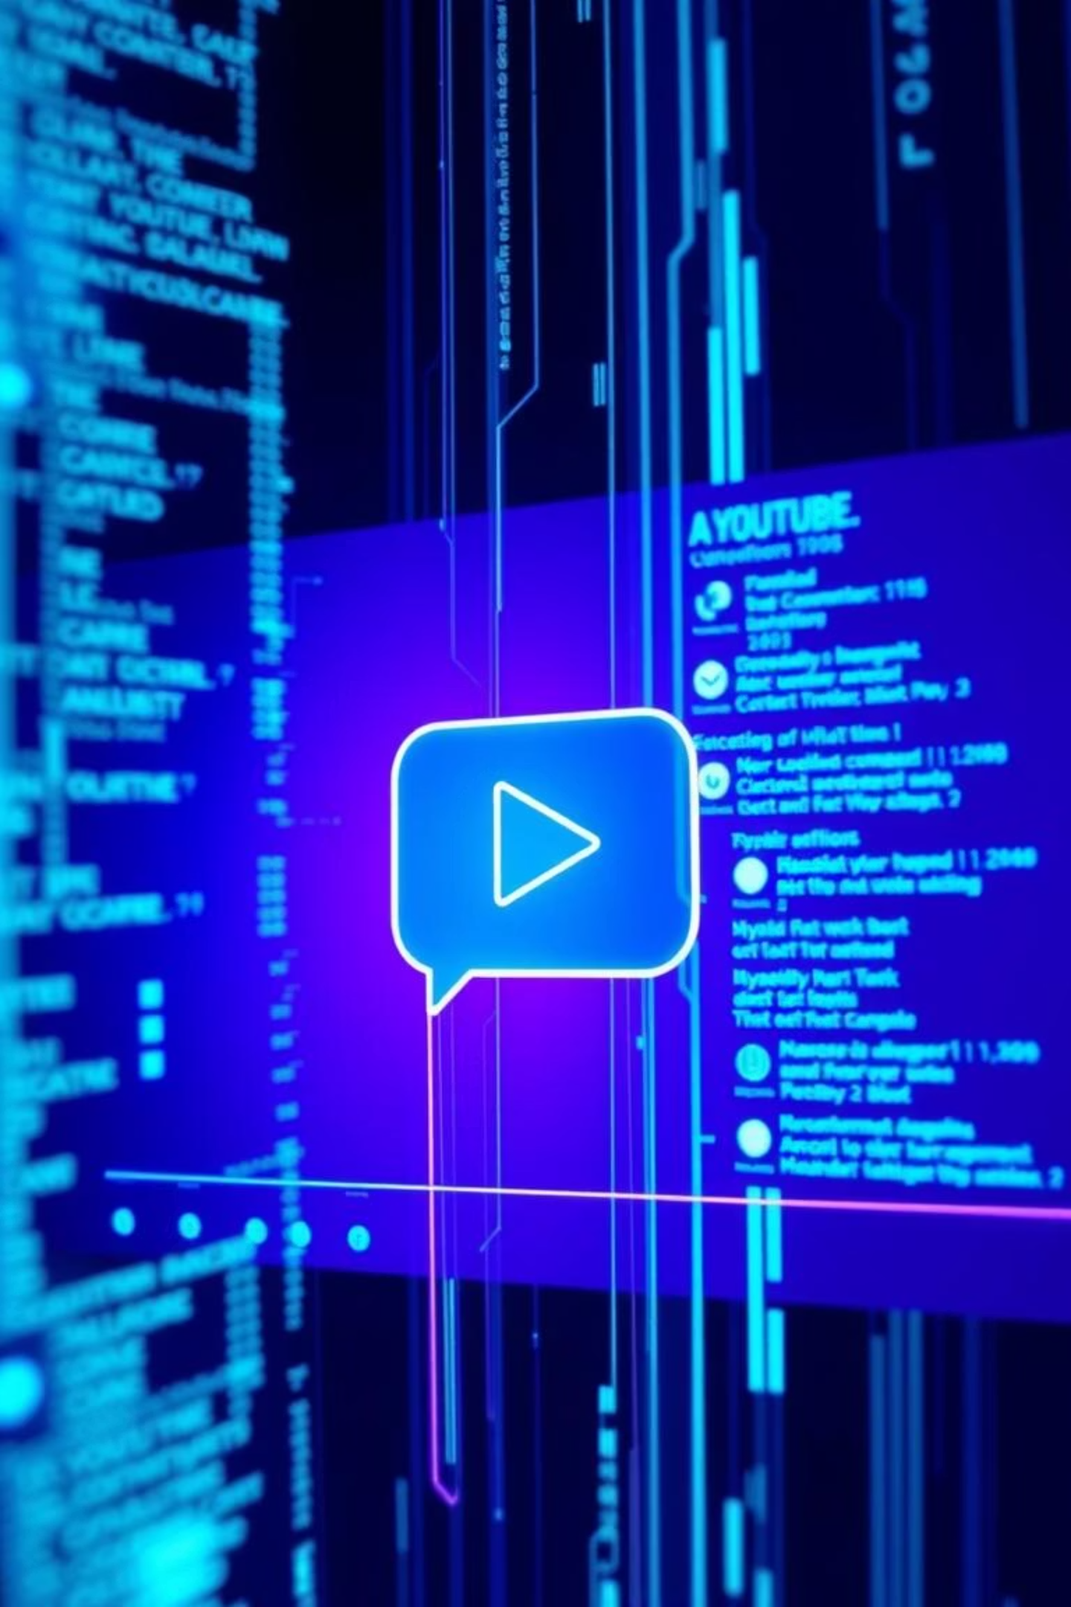
Multimodal AI Chatbot for YouTube Video QA
by Mercy Moparthy
Notes:
Good Morning, everyone! Welcome to My presentation on the development of a Retrieval Augmented Generation (RAG) AI chatbot which is designed to answer questions about specific YouTube videos.

Slide 2
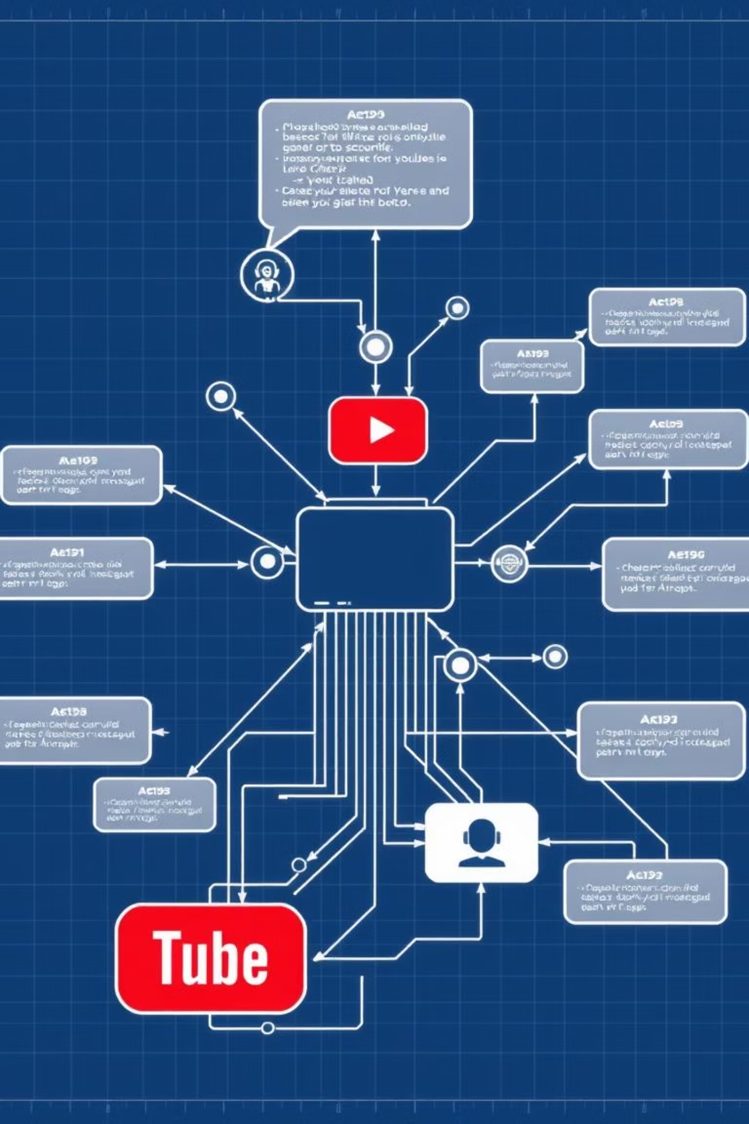
Project Planning & Scope Definition
Developing a RAG (Retrieval Augmented Generation) AI chatbot for YouTube videos, utilizing both audio and text data. This project aimed to explore practical RAG workflows, multimodal data, and deliver an end-to-end demo relevant to ServiceNow content.
Notes:
This project leverages both audio and text data, extracted directly from the videos, for accurate responses. Over the next few minutes, i’ll walk you through the architecture, and implementation of this solution

Slide 3







System Pipeline Architecture
Data Collection & Transcription
Audio extracted from YouTube videos, converted to text.
Data Preprocessing & Embedding
Text chunked, embedded, stored in vector database.
Query Processing & Retrieval
User questions processed, relevant text retrieved.
LLM Integration & Generation
Context and query fed to LLM for answers.
Answer Delivery
AI-generated answers presented to the user.
Notes:
The process begins with Data Collection & Transcription—here, we extract audio from YouTube videos and convert it into text.
Next, in Data Preprocessing & Embedding, the text is chunked, embedded, and stored in a vector database for efficient retrieval.
Moving to Query Processing & Retrieval, user questions are processed, and relevant text is retrieved from the database.
Then, in LLM Integration & Generation, the context and query are fed to a Large Language Model to generate accurate answers.
Finally, Answer Delivery presents these AI-generated answers to the user in a clear, concise manner.
This structured pipeline ensures our chatbot delivers precise, context-aware responses from YouTube video content.

Slide 4
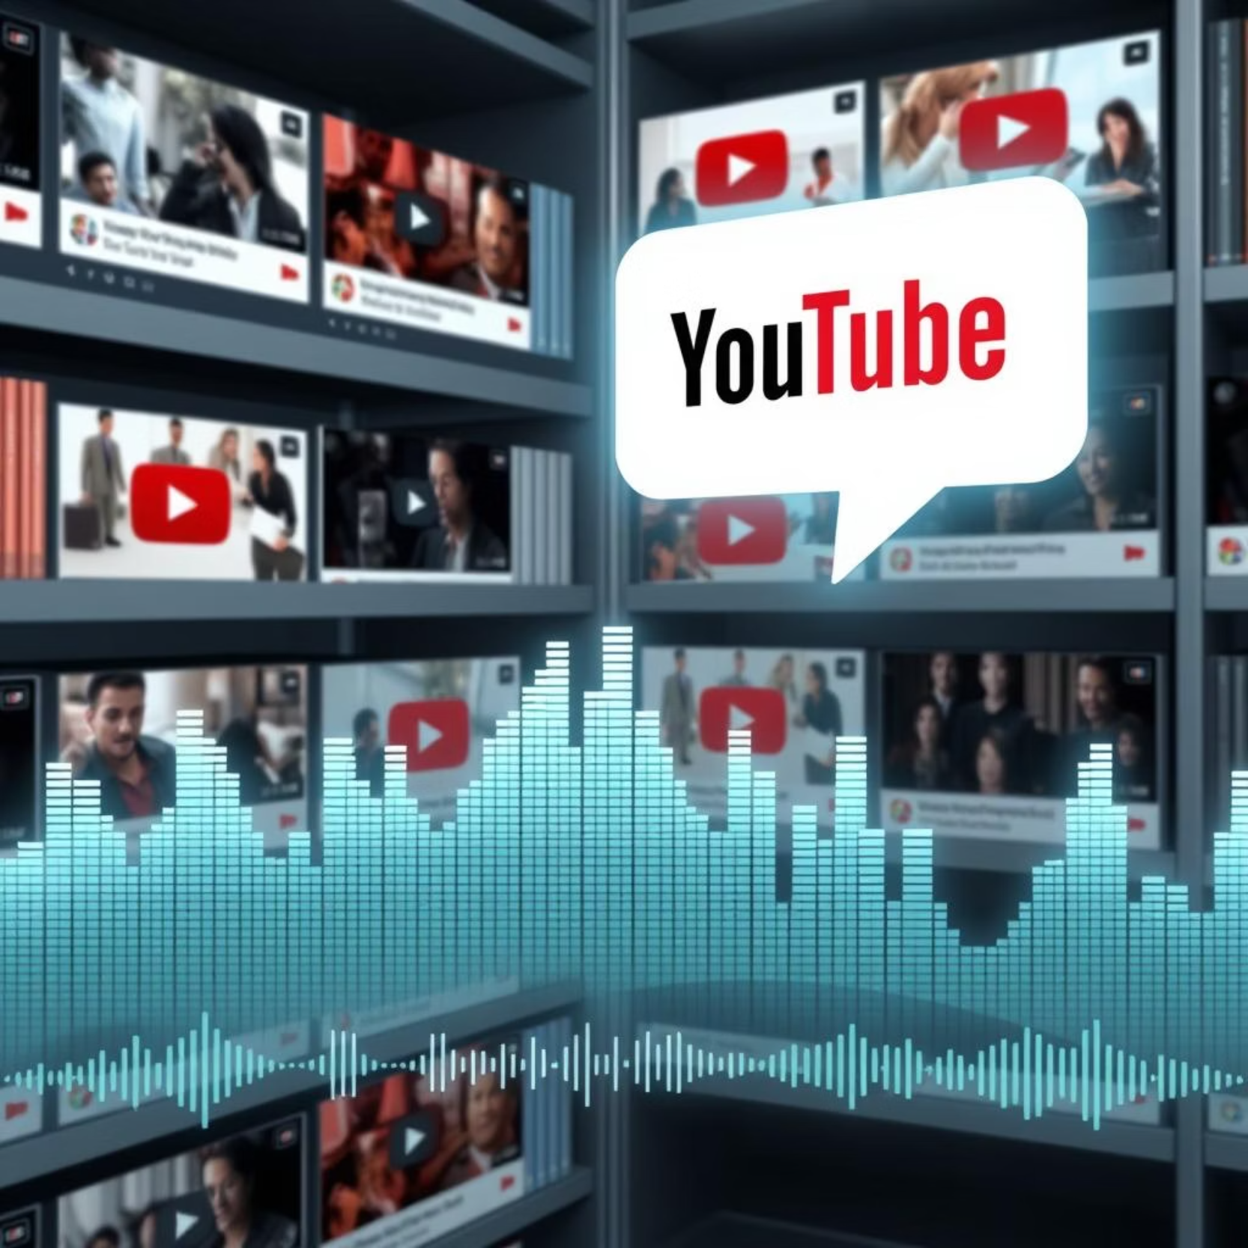
Data Ingestion & Transcription
Curated 22 relevant ServiceNow YouTube videos. Created detailed CSVs with metadata (titles, URLs, publish dates, duration) for content tracing.
Downloaded raw audio (MP3) from selected videos using `youtube-dl` to cloud storage for transcription.
Speech-to-Text (ASR)
Transcribed all audio files using OpenAI Whisper `large-v2`. Modularized transcription logic in a Jupyter notebook for scalable processing.
Metadata Management
Collected, cleaned, and organized video metadata (titles, durations, YouTube links, channel names). Ensured accurate linkage between metadata and transcribed text for efficient retrieval and UI features.
Notes:
I started with Speech-to-Text using the OpenAI Whisper large-v2 model, which is known for its high accuracy in converting YouTube video audio into searchable text.
To manage this efficiently, I organized transcription tasks in a dedicated Jupyter notebook, enabling scalability for large datasets.
Accurate and scalable transcription is crucial, as it powers the downstream text retrieval and question-answering capabilities.
After that I focused on Metadata Management, collecting key details like video titles, durations, YouTube links, and channel names.
This metadata was cleaned, standardized, and linked to transcripts, ensuring each segment ties back to its source video.
Robust metadata enhances retrieval precision, provides clear references, and supports features like displaying video titles or links with answers.

Slide 5
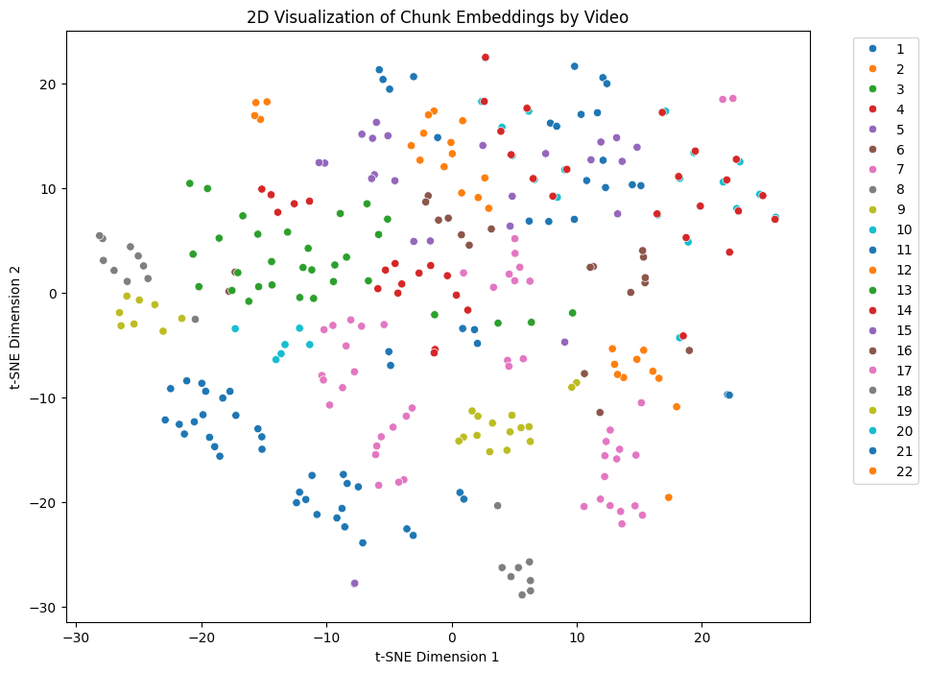

Index type: IndexFlatL2 for quick prototyping
Index type: IndexFlatL2
Index type: IndexFlatL2
Index type: IndexFlatL2
Data Preprocessing & Embedding
Text Chunking
Long transcripts were divided into smaller, semantically coherent chunks, ensuring manageable sizes for retrieval and LLM context.
Chunk size: 500 characters
Overlaps: 100 characters
Notes:
Text chunking breaks long transcripts into smaller, manageable sections—typically 500–1000 characters per chunk but I choose 500 characters per chunk—with 100-character overlaps to preserve key information.
I used tools like LangChain’s RecursiveCharacterTextSplitter to automate this, linking each chunk to its video metadata, such as title and timestamp.
This enables quick, accurate searches through chunks rather than entire transcripts, boosting the chatbot’s speed and context provision.

Slide 6



Query Processing & Retrieval
Vectorization -FAISS
Query Input & Embedding
Context Assembly
Each text chunk was transformed into high-dimensional numerical embeddings using a robust language model, capturing semantic meaning.
User questions are transformed into vector embeddings for precise semantic search within the system.
Retrieved, relevant text chunks are compiled to provide detailed context for the large language model.
FAISS: FAISS-CPU package
Index Type: IndexFlatl2
Retrieval top_k: 3-5 chunks per query
Query Embedding: all-MiniLM-L6-v2
Query embedding dimension: 768
search_type="similarity",
search_kwargs={"k": 5}
Notes:
Vectorization—where transcript chunks are converted into vector embeddings using models like “sentence-transformers” or OpenAI embeddings.
These embeddings are stored in a vector database, either FAISS for local prototyping or Pinecone for scalable cloud deployment.
During query time, the user’s question is embedded, and the vector database retrieves the most similar chunks as context for the LLM.
This approach ensures scalability for millions of chunks, enhances accuracy with semantic search, and delivers fast retrieval—key for a responsive chatbot.
The database is pre-populated during data prep and queried live during the RAG process.
We can input queries as text or voice, which are converted into embeddings—numerical vectors capturing the query’s meaning using models like sentence-transformers.
These embeddings enable semantic search, finding relevant transcript chunks even if the wording differs, by comparing them to stored vectors in the FAISS database.
The system retrieves the top N most similar chunks, providing context for the Mistral-7B LLM to generate accurate answers.
This semantic approach boosts accuracy, focusing on meaning rather than just keywords. Our chatbot supports multimodal inputs—text and voice—enhancing usability for all users.
Embeddings are created automatically for both stored transcript chunks and runtime queries, streamlining the process.
The FAISS vector database ensures fast, efficient similarity searches, while integration with Mistral-7B delivers high-quality, grounded responses.
This powerful retrieval mechanism makes our chatbot responsive and precise

Slide 7
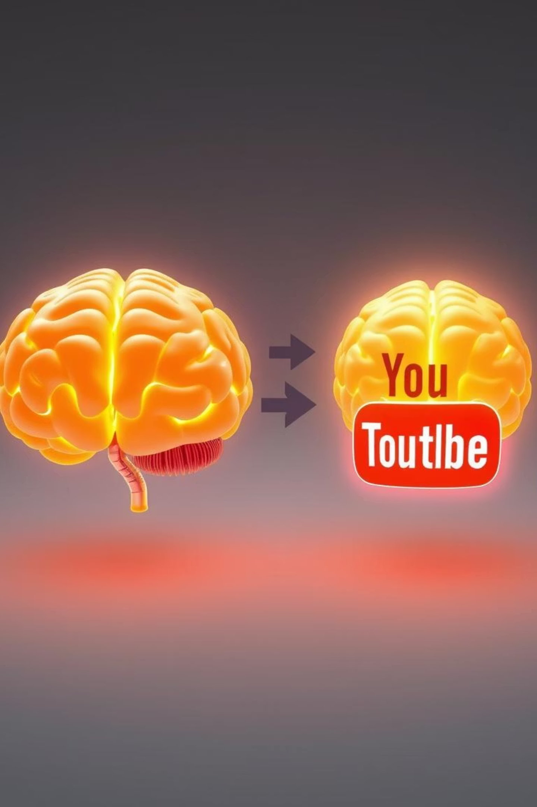


LLM Integration & Generation
Initial Plan: Llama-3-8B
Considered Llama-3-8B for its strong QA performance.
Intermediate Models:
Distilgpt2
Flan-t5-base
Flan-t5-large
Final Selection: Mistral-7B, Whisper
Switched to Mistral-7B & Whisper with and without Agents for its efficiency, lightweight nature, and excellent RAG results, making deployment easier.
Notes:
My initial plan considered Llama-3-8B for its strong question-answering performance, setting a solid foundation. However, I am unable to continue with this model due to system stats issue.
So, I tried exploring intermediate models: Distilgpt2, Flan-T5-base, and Flan-T5-large, evaluating their capabilities.
At the end, I continued with Mistral-7B and Whisper for the final selection, chosen for their efficiency, lightweight nature, and excellent RAG results, making deployment easier.
Retrieval Agents (Retrieval-Augmented Agents) used in Whisper which gave more prompt answers as agents as “decision-makers” that can choose and orchestrate tools for flexible, dynamic responses.
This process begins with Context Gathering—relevant transcript chunks are retrieved from the FAISS database after a query is embedded and searched.
And then Prompt Construction combines the user’s question, retrieved chunks, and instructions to ensure answers are based on transcript data. In LLM Generation, Mistral-7B and Whisper process this prompt to deliver natural, accurate answers grounded in YouTube content.
Responses are presented via the Gradio interface, often with source video details like titles or links for transparency.
This approach ensures grounded, precise answers, enhancing accuracy and explainability, with a technical setup using LangChain for context retrieval, prompt building, and generation.

Slide 8
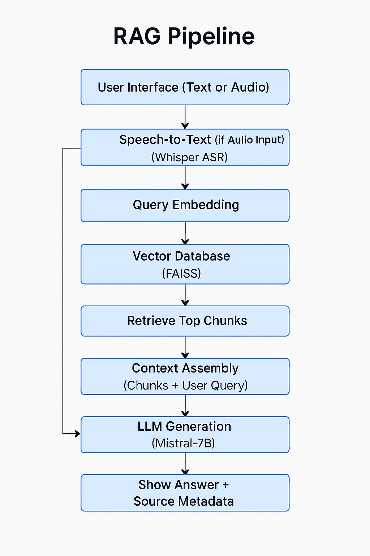
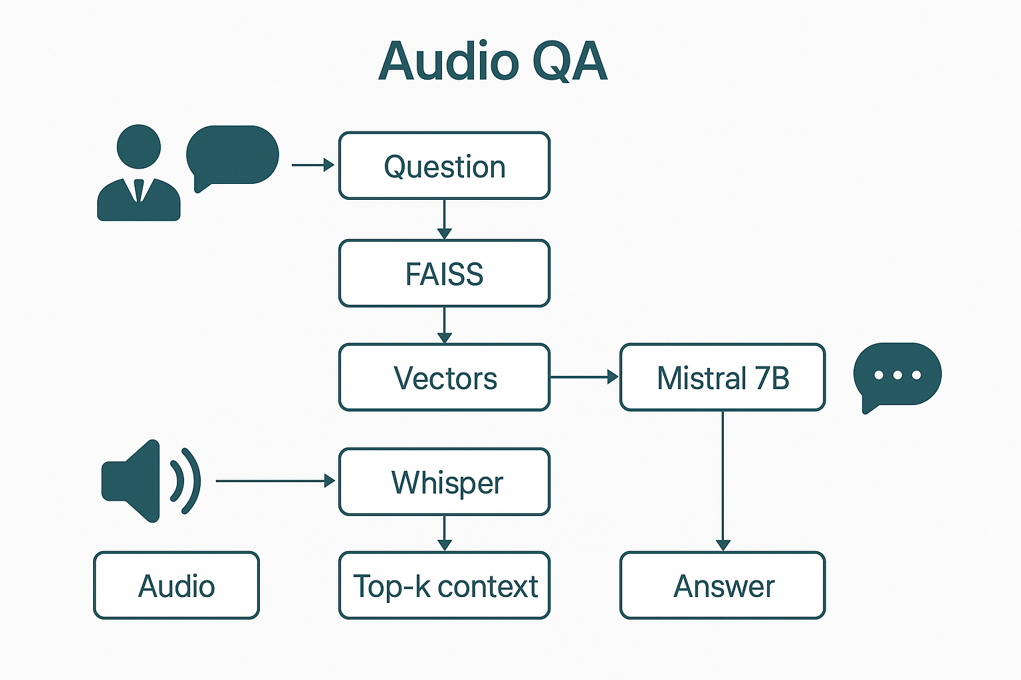
RAG Pipeline
Audio QA
Built a LangChain pipeline: query embedding, relevant chunk retrieval from vector DB, prompt construction, and Mistral-7B LLM answer generation grounded in video content.
Added support for user voice queries, converting spoken input to text via Whisper. This enhances user experience and showcases multimodal capability.
Notes:
RAG enables our chatbot to answer YouTube video questions using transcripts and metadata, starting with User Query Input via the Gradio interface, where audio is transcribed to text with OpenAI Whisper.
Next, Query Embedding converts the text into a numerical vector using a pre-trained model, capturing its meaning for semantic search.
In Retrieval from Vector Database, this embedding searches the FAISS database, retrieving the most relevant transcript chunks based on similarity.
Prompt Construction then combines these chunks with the original question to guide the LLM. LLM Generation uses Mistral-7B to process the prompt and generate an answer grounded in the context.
Finally, Answer Delivery displays the response in Gradio, optionally with metadata like video titles or timestamps for transparency.
This pipeline ensures relevance and accuracy by rooting answers in actual video content, with transparency via traceable transcript segments.
Project highlights include chunked transcripts for better retrieval, FAISS for efficient local search, LangChain for streamlined processes, Mistral-7B for strong performance, and modular Jupyter notebooks for scalability.

Slide 9
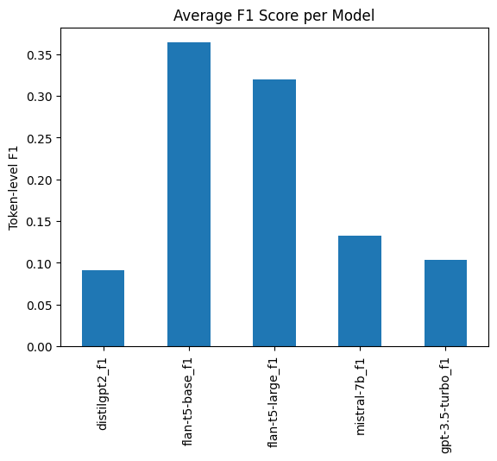
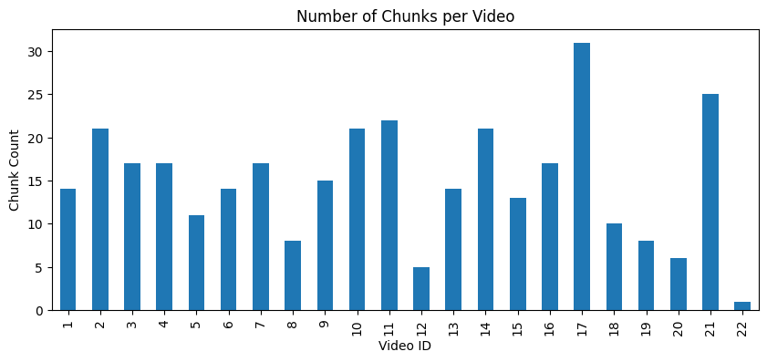
Evaluations & Metrics
No of Chunks per Video
F1 Score Per Model
Notes:
In this evaluation, although Flan-T5 models achieved higher F1 scores, manual inspection revealed that Mistral-7B’s answers were often more robust and contextually nuanced.
This highlights the importance of not relying solely on automated scoring metrics for open-ended question answering tasks.

Slide 10
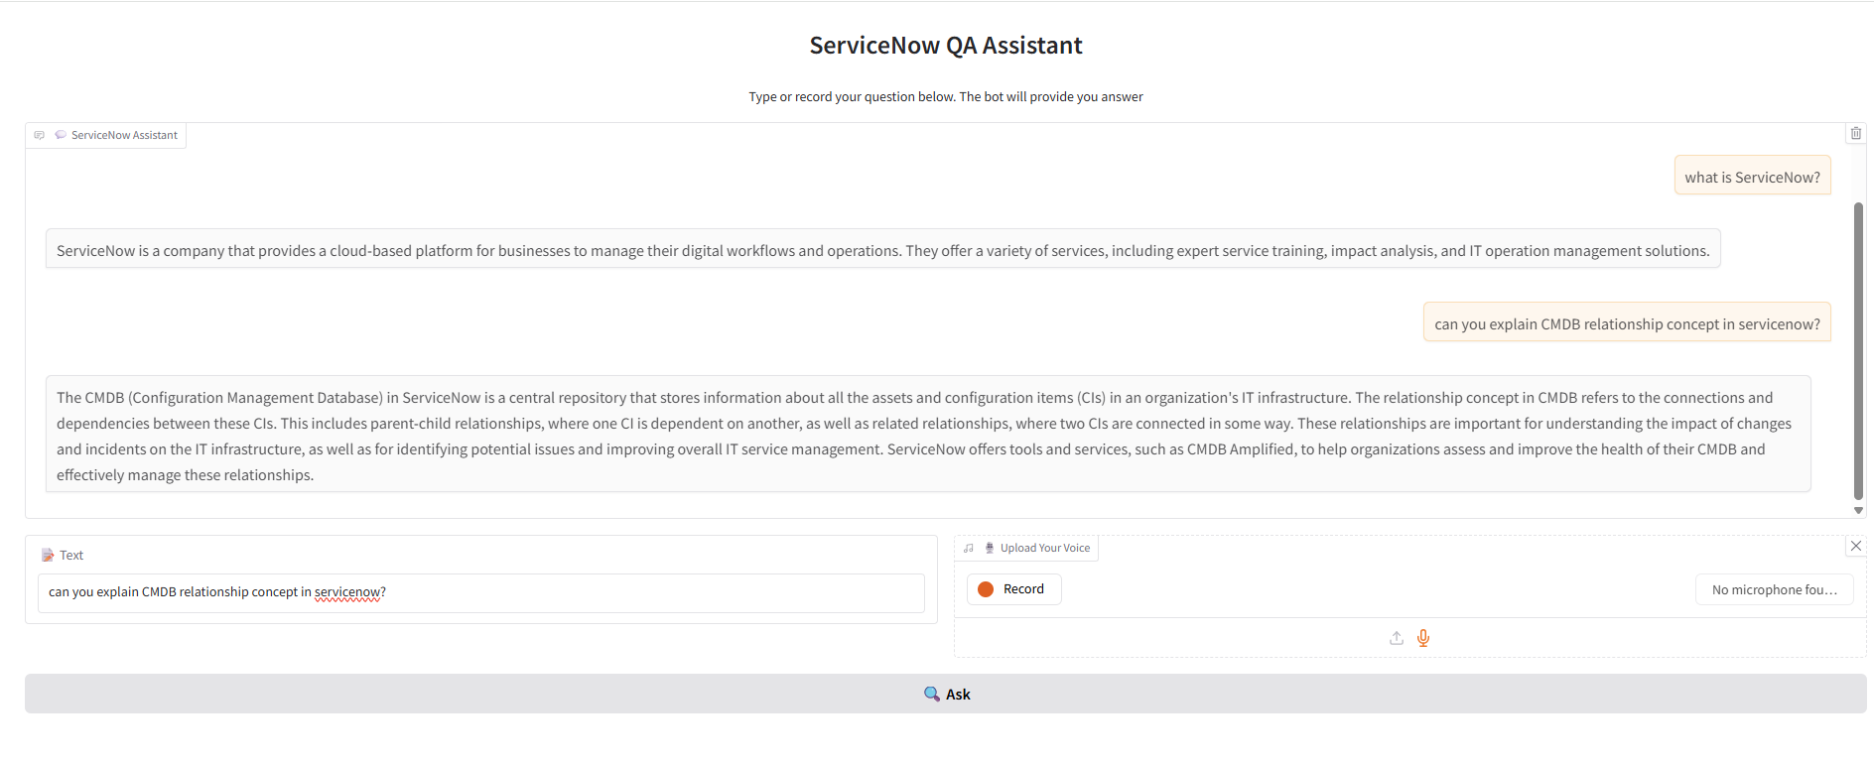
User Interface & Deployment
Tool: Gradio
Model: Whisper without Agent
LINK:
Notes:
I used basic RetrievalQA chain

Slide 11
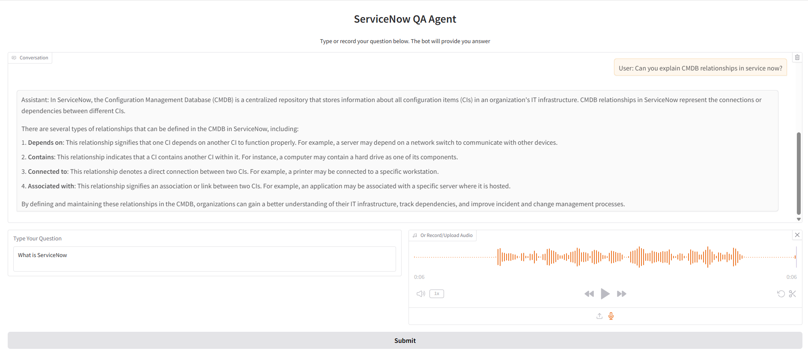
User Interface & Deployment
Tool: Gradio
Model: Whisper with Agent
LINK: http://127.0.0.1:7872
Notes:
agents in LangChain dynamically plan how to answer based on the user’s input.
agents as “decision-makers” that can choose and orchestrate tools for flexible, dynamic responses.
In future versions, I will try add agents—components that decide how to handle each query, possibly combining multiple tools or steps for more complex tasks.

